Slide 1

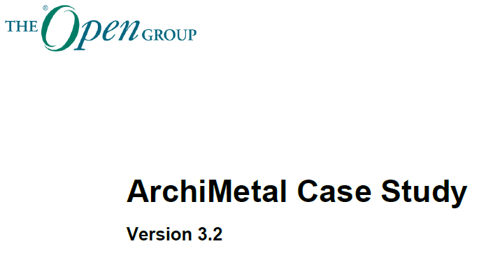

ArchiMetal Modeling Practice
Using Archi Tool
Repository: https://github.com/yasenstar/ArchiMetal_Practice.
Check online page: https://yasenstar.github.io/ArchiMetal_Practice/

Slide 2

Initialization
Overview of ArchiMetal Case Study
Repository in GitHub
Mindmap for Structure
Create Initial Archi Model

Slide 3
Figure 01: ArchiMetal Business Units
ArchiMetal Transformation Challenges
Repository: https://github.com/yasenstar/ArchiMetal_Practice.
Check online page: https://yasenstar.github.io/ArchiMetal_Practice/

Slide 4
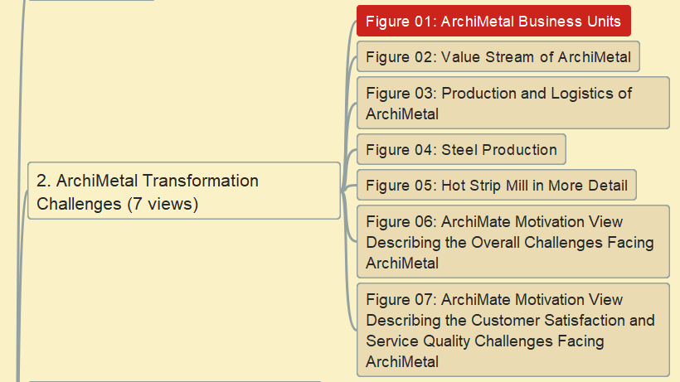
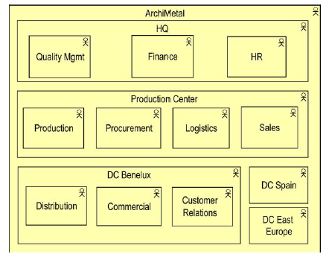
Figure 01: ArchiMetal Business Units

Slide 5
Figure 02: ArchiMetal Value Stream
ArchiMetal Transformation Challenges
Repository: https://github.com/yasenstar/ArchiMetal_Practice.
Check online page: https://yasenstar.github.io/ArchiMetal_Practice/

Slide 6
Figure 03: Manufacturing Process – Production and Logistics
ArchiMetal Transformation Challenges
Repository: https://github.com/yasenstar/ArchiMetal_Practice.
Check online page: https://yasenstar.github.io/ArchiMetal_Practice/

Slide 7
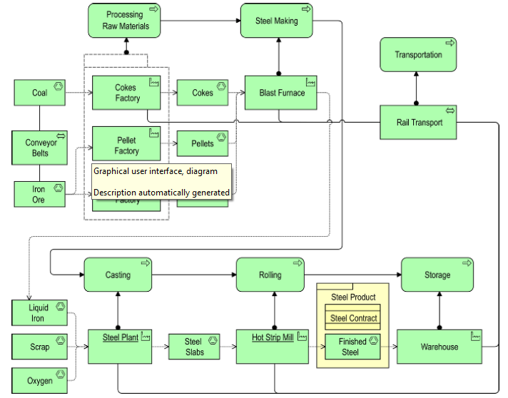
Figure 04: Manufacturing Process – Steel Production
ArchiMetal Transformation Challenges
Repository: https://github.com/yasenstar/ArchiMetal_Practice.
Check online page: https://yasenstar.github.io/ArchiMetal_Practice/

